Slide 1









Values Campaign Strategy
Elevation GDL to
Values ambassadors

Slide 2




AGENDA
01
Team
05
Resources
Modificar con base a los slides finales
02
06
Performance Indicators
Overview
03
Scope
07
Plan
04
Branding and Promotion
Notes:
Yos

Slide 3
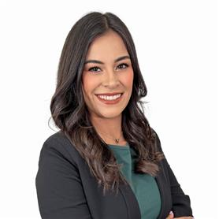
TEAM
Agregar solamente a quienes estamos trabajando con la campaña de valores
Yoselin Ibarreche ​
XXX
xxx
TALENT EXPERIENCE LEAD
IMMERSION LEAD
IMMERSION SUPPORT
Notes:
Yos

Slide 4
En el slide 9 (Overview) reducir a un statement la definición del problema. Los objetivos son la razón que generaron los KPIS ( ie. Increase knowledge), y los KPIS traducirlos a: Knowledge awareness 90% of the entire opopulation of the GDL office
01
Action Items
De la definición por dinámica mensual (tú creaste un word de cada una), generar un renglón de cada una: ie. Dinámica 1: Lead the way: Fostering leadership – May 24th
02
03
04

Slide 5
Objectives
1
Increase knowledge of corporate values Help employees better understand and identify with the company’s values.
Improve employee commitment and participation Foster consistent involvement in value-driven activities and team dynamics.
Create a culture of integrity and recognition Encourage peer acknowledgment and reinforce behaviors aligned with core values.
2
3

Slide 6




Performance Indicators
Knowledge growth Achieve a 90% increase in value understanding as measured by pre- and post-campaign surveys.
Participation rate Ensure a minimum 90% attendance in scheduled activities by tracking participation among registered employees.
Recognition engagement Implement a monthly nomination system and track the number of peer nominations for value-aligned behaviors.
Notes:
The final evaluation consists of preparing a presentation in Spanish for the group. The evaluation will come in the middle of the period.

Slide 7
Overview
Employees in GDL are facing challenges integrating into the organizational culture. The office is new and lacks appeal, the team is recently formed, and there is limited awareness and practice of company values. As a result, there is no strong sense of community or shared identity.
Objective
Mission
Reconnect GDL employees with the company culture by fostering a sense of belonging, promoting value-based behaviors, and building a strong, engaged community through hybrid and meaningful experiences.
To foster a vibrant, participatory, and value-driven culture where every individual becomes an ambassador of our core values through meaningful, hybrid, and emotionally engaging experiences.
Notes:
Ricardo

Slide 8
Culture values importance
IMPORTANCE
The values and culture foster a positive work environment, enhance engagement, drive success aligning everyone with the company's mission and promoting ethical behavior
GOAL
Become true ambassadors, we embrace and embody our core values, shaping interactions and driving collective success through memorable, meaningful, and transformative experiences.
BENEFITS
-Higher Job Satisfaction -Lower Turnover Rates -Higher Efficiency -Innovation -Better Service -Positive Public Perception -Adaptability -Social Responsibility -Customer Trust And more…

Slide 9







Scope
Kick-off
Thursday, May 22nd
Target Audience
All GDL employees (new and experienced) seeking to connect with company culture and practice core values in hybrid environments.
Delivery Mode
Impact
In-person sessions min 30 people per session
30% of the professionals at the GDL Office
Frequency
1 session per week (each thursday), 1-hour sessions.
Experiences
Talks, games, recognition sessions
Duration
5 months (1 month per value with kick off and closure session)

Slide 10
Activities Original
Kick-off
Thursday, May 22nd
Value | Activity | Date | Venue | Session Type | Description
Kickoff | Two truths one lie | 22-May | Site | Kickoff | Icebreaker to introduce company values.
We lead the way | Leadership talk | 29-May | Remote | Talk | Talk about Deloitte's leadership stories.
 | Paper plane leaders | 5-Jun | Site | Game | Paper plane game on leadership dynamics.
 | Leadership talk reinforcement | 12-Jun | Remote | Talk | Leadership styles review session.
 | Solve the scenario | 19-Jun | Site | Game | Scenario game on ethical decisions.
We serve with integrity | Integrity & service talk | 26-Jun | Remote | Talk | Talk with real service integrity stories.
 | Integrity tower | 3-Jul | Site | Game | Build tower while reflecting on integrity.
 | Integrity & service talk | 10-Jul | Remote | Talk | Session on living with integrity.
 | Integrity dice | 17-Jul | Site | Game | Board game about service and integrity.
Take care of each other | Take care of each other beyond the words | 24-Jul | Remote | Talk | Talk about caring for each other.
 | Family Day | 31-Jul | Site | Recognition Event | Family bonding event at the office.
 | Take care is culture not causality | 7-Aug | Remote | Talk | Talk on daily culture of care.
 | Pet Day | 14-Aug | Site | Event | Pet-friendly day to promote empathy.
Foster the inclusion | Sensibilization talk | 21-Aug | Remote | Talk | Talk on neurodiversity and inclusion.
 | Deaf talk people with deloittes participants | 28-Aug | Site | Talk | Disability trivia and awareness talks.
 | Inclusion Talk | 4-Sep | Remote | Talk | Inclusive talk with deaf participants.
 | Half and half | 11-Sep | Site | Reflection Activity | Talk on cultural inclusion and success.
Collaborate with measurable impact | Historia del impacto de trabajo colectivo | 18-Sep | Remote | Talk + Trivia | Team reflection with maze activity.
 | Riddle puzzle | 25-Sep | Site | Game | Trivia and stories on team impact.
 | Collaborate Talk | 2-Oct | Remote | Talk | Team puzzle-solving activity.
 | Collective effort makes difference | 9-Oct | Site | Visual Recognition | Talk on collaborative work.
Closure event | Share your takeaways | 16-Oct | Site | Closure | Post-it wall for teamwork recognition.
Notes:
Poner un standar de mínimo participantes. Por lo menos un grupo de 10 personas, en cualquier session menor a ese número de personas
Definir el mejor día de la semana y horario

Slide 11
Activities
Kick-off
Thursday, May 22nd
Value | Activity | Date | Session Type | Description
Kickoff | Two truths one lie | 22-May | Kickoff | Icebreaker to introduce company values.
We lead the way | Leadership talk | 29-May | Talk | Talk about Deloitte's leadership stories.
 | Paper plane leaders | 12-Jun | Talk | Paper plane game on leadership dynamics.
We serve with integrity | Integrity tower | 26-Jun | Game | Build tower while reflecting on integrity.
 | Integrity dice | 10-Jul | Game | Board game about service and integrity.
Take care of each other | Take care of each other beyond the words | 24-Jul | Talk | Talk about caring for each other.
 | Family Day | 7-Aug | Gathering | Family bonding event at the office.
Foster the inclusion | Sensibilization talk | 21-Aug | Talk | Talk on Physical and neurodiversity inclusion.
 | Deaf talk people with deloittes participants | 4-Sep | Talk | Disability trivia and awareness talks.
Collaborate with measurable impact | Collective work meanigful results | 18-Sep | Talk + Trivia | Talk on collaborative work.
 | Collective effort makes difference | 2-Oct | Game | Post-it wall image 8 bit
Closure event | Share your takeaways | 16-Oct | Closure | Recognition event, talk, food and pictures
Notes:
Poner un standar de mínimo participantes. Por lo menos un grupo de 10 personas, en cualquier session menor a ese número de personas
Definir el mejor día de la semana y horario

Slide 12
Branding and Promotion
Modificarlo.
La idea es ver cómo se va a llamar la campana, cómo lo vamos a difundir y si vamos a tener incentivos para generar engagement
Campaign’s Name
Communications
Incentives
Pending
Review options:
Spanish for Success
Cultural Connect
Español Expedition
Emails
Post in US GDL office Channel
Include information in Unwrapped from each Portfolio
Certificate of completion
Email for recognition
Amazon gift card for top 3 students (each period)
Notes:
Nombres de la campaña:
Spanish for Success
Culture Immersion: Habla español
Spanish Connection
Spanish one on one
Cultural Connect
Habla español
Español Expedition
Language and Culture: Español
*Poner a votación durante el Focus Group
La tarjetas de regalo seria para dar un premio al final del periodo (posterior a los 3 meses y después al final de los 6 meses), hacer los criterios para determinar quienes pueden ganar los premios. (Ricardo)
no hay incentivo de amazon Cards, podríamos tener giveaways de Deloitte
El beneficio es el que estén

Slide 13





Resources
Que recursos se necesitan?
Humanos, training, comuncation, tecnologia, incentivos, budget.
Resource |  | Description
 | People | 1 Spanish language teacher and cultural expert and 1 Back up for facilitating the classes, training developer and support
 | Training Materials | Student guide ,quizzes, Instructor Led Training and Quick Reference Guide
 | Communication materials | Emails, Memos and Infographics
 | Technology tools | Projector, computer, speaker, microphone, Quizziz, and Miro
 | Budget | $ 6,000 MXN
Notes:
2 personas
1 instructor, materiales/ información
2 logística, materiales, seguimiento de participantes, comunicados
Materiales:
Manual del participante: agregar criterios de evaluación, reglas de las clases, darles ejercicios y los temas de la clase
Quizzes
Proyector
Bocinas
Attendance survey and satisfaction survey

Slide 14
Partnerships estrategicos
Colaboracion conb departamento de eventos para itnegrar tematica de vallors en eventos ya programados maximizando los recursos y exposicvion

Slide 15
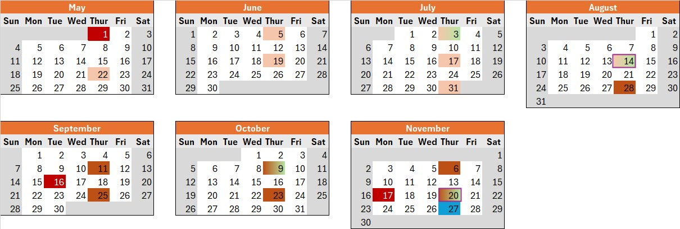
Calendar
Dependiendo la propuesta, cuando tendríamos sesiones presenciales, o los juegos, o la session de kick off, etc.
Lead The way – Fostering leadership May 24th
Lead The way – Fostering leadership May 24th
Lead The way – Fostering leadership May 24th
Lead The way – Fostering leadership May 24th
Lead The way – Fostering leadership May 24th
Notes:
The final evaluation consists of preparing a presentation in Spanish for the group. The evaluation will come in the middle of the period.

Slide 16


Plan
Cuál es el plan de todos los key points y milestones
Activity | Mar | Apr | May | Jun | Jul | Aug | Sep | Oct | Nov
Revisión del Case
Edición de comunicación
Presentación con Susy
Develop Curriculum & Materials
Kick-off
Conduct sessions
Feedback
Evaluation
Closing session
03/21
04/03
04/08
04/24
04/10
04/03
05/02
09/02
10/03
05/22
05/22
08/14
08/28
11/20
08/14
11/20
07/03
08/14
10/09
11/20
11/27

Slide 17
Next steps
Cuales son los siguientes pasos a trabajar después de la junta con susy
Activity | Purpose | Start Date
Notes:
Yos
Focus group
Identificar un minimo grupo de participantes
Aprobaciones con nadia y ruth
Comunicación tiene que ser Abierto a toda la oficina de GDL con canal de registro
Identificada nuestra audiencia y controlada metricas en base a eso
Despues la comunicación de restringe al grupo que se inscribió al programa
Conectar con la gente de qtro para tener moment that matters y cultural awareness. Colaboración global, no comibimos ni colaboramos. Puede apoyar a la colaboración.
Cultural awareness, esfuerzos de cross – colaboración Mexico, us, usi. Y temenos que buscar la forma de cómo colaboramos mejor.
Fomentar los valores de Deloitte con cultura más inclusive con ellos
No ser inclusivos es hablar en español enfrente de ellos, los pones en el límite de que no me interesa que entiendas lo que digo
Objetivo: tener herramientas / palabras/para eliminar esas barreras

Slide 18
Values Campaign: Living our values shaping our future
We aim to become true ambassadors of our core values by creating memorable, meaningful, and transformative experiences that align words with actions.
Objectives
Strategy
Bridge the gap between declared values and everyday behaviors and become values ambassadors
Deliver consistent hybrid (remote + in-person) experiences.
Foster a culture of participation, emotional engagement, and recognition.
Formats: Talks, games, dynamics, and storytelling.
Emotional engagement: Real stories, charms, symbolic items.
Incentives: Prizes, gift cards, stickers, thermos.
Gamification: Trivia, contests, participation rewards.
Timeline: 5-month campaign (June–October 2025) one event each week.
How?
Key Deliverables
Risk & Mitigation
Success Indicators KPIs
Target Segmentation - Availability: Remote vs On Site - Preference of activities: Collaborative vs Individual learning, creative, networking etc.
Activity calendar Hybrid weekly events Charms/pins & materials Pre/post campaign surveys Results report
Low budget → Fit activities various budget options and offer different incentives Low engagement → Make sure leaders understand the purpose and impact of the campaign Communication → Standardize event invitation and confirm attendance assistance
- 70% weekly attendance Satisfaction in surveys - High participation in activities survey opinion - Testimonials -survey values focused
Implementation Timeline
Phase
1
2
3
4
5
6
7
Activity
Diagnosis
Content design
Production and Logistics
Validation
Consolidation
Communication
Launch
Date
Apr 1 - 4
Apr 7 -11
Apr 14 - 18
Apr 21 -25
Apr 28 - 30
All May
June 1st week

Slide 19
Scope – How and what?
02
Frequency: Weekly activity alternating between in-person and remote activities at least the first two months then will be all in- person sessions
01
Duration: 5-month campaign​
04
03
Awards and recognition system:
Gift cards
Charms
Stickers
Nomination Pen prize / Pin/ charm
Notebooks
T-shirts
Thermos
Activity types:
Competitive
Wellness-oriented
Knowledge & learning focused
Creative & experimental
Networking

Slide 20

Scope – Human Resources
02
Frequency: Weekly activity alternating between in-person and remote activities at least the first two months then will be all in- person sessions
01
Duration: 5-month campaign​
04
03
Awards and recognition system:
Gift cards
Charms
Stickers
Nomination Pen prize / Pin/ charm
Notebooks
T-shirts
Thermos
Activity types:
Competitive
Wellness-oriented
Knowledge & learning focused
Creative & experimental
Networking

Slide 21
Scope – Financial Resources
02
Frequency: Weekly activity alternating between in-person and remote activities at least the first two months then will be all in- person sessions
01
Duration: 5-month campaign​
04
03
Awards and recognition system:
Gift cards
Charms
Stickers
Nomination Pen prize / Pin/ charm
Notebooks
T-shirts
Thermos
Activity types:
Competitive
Wellness-oriented
Knowledge & learning focused
Creative & experimental
Networking

Slide 22
Scope
Recursos Necesarios
Humanos: facilidatoares itnernos y externos personal de soporte para eventos y lioderes de equiuop para pormover y moniteorar activiades
Financierop presupuesto para premios materiales honrarios de fdacilitadores etrc y comida

Slide 23
Participation MEcahnism
Inscripocion previa
Acceso remote
Estrategia de comuinicacion
Lanzamiento de campal;a anuncio official a travez de un evento kcick off
Actualizaciones regulares comunicadop semanales via email publiacaciones para mantener el itneres del publico
Cierre de campa;la con impacto evento de clausura que resuma los logros y reconozca contribuciuones destacadas

Slide 24
Colaboraciones
Integracion con eventos corpoartivos ya agendados que agreguenb el tema de los valores a sus presentaciones
Poartnershipo con otros departamentos clave

Slide 25
Branding poromotion
Logo de campa;a y tema visual por ejeligr
Material promocional como stickers anuncionos para pantallas etc libretas plumas etc
Comunicacion integral
Canales de comunicacion: email teams
Mensajes clave: que representen cada valor

Slide 26
Branding poromotion
LoCampa;a de lanzamiuento
Video de lanzamiento
Recompensas y reconocimientos
Sistema de incentivbos
Ceremonias de premiacion

Slide 27
KPIS y medicion del extio
Tasa de participacion en eventos
Porcjettane de emeplados que asisten a los eventos comparado con el total de empleados
Alcan zar un 90% de participacion de invitados
Numero de reconocimientos otorgados
Cantidad de reconocimientos otorgados
Numero de reconocimientos dados al principio y al final de la campa;a
Encuestas de staifsaccion
Evaluaciuoinb de pa percepcion y comprension de los valores antes y despuies de la campa;a
Al menos el 90% de empleados puede expresar antes y despues su entendimiento de los valores yla parecepcion de como es que se viven los valores
Feedback post evento
Analisis de costo beneficio
Evaluacion de los costos totals de la campa;l;a vs los benefiocios cuantificables

Slide 28
Next Steps
Aprpbacion del propyecto
Planificacion detallada
Lanzamiento de campa;a

Slide 29
no actividades en remoto, esta iniciativa es siempre in person
los 5 meses serían de junio a diciembre, no?
low budget no es una limitante, no tenemos limite de budget
cómo mides la participación?
el contenido no puede estar en 1 semana
en el time line: poner acabar la estrategia, aprobación, comunicación con el team de comunicación para tener branding y la estragia de comunicación, produccion y logistica es durante todo el tiempo. Buscar a la gente que te apoye como expositores para los consolidación, el lauch day se puede mover.
en tu estrategia debes de crear el "cómo" general del plan. Cuantas pláticas, de quienes? como refuerzas? unión con otros eventos? que comunicación necesitas? recursos necesarios en general?

Slide 30
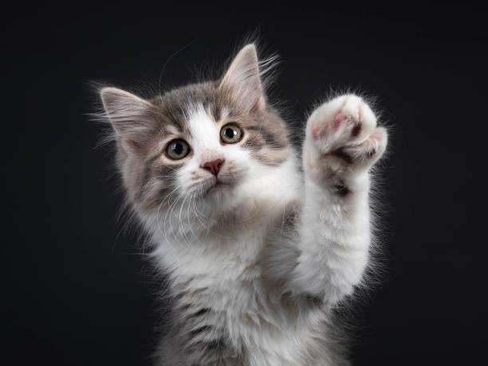

Thanks!

